Slide 1
L4 Maths Group Presentations

Slide 2
Learning Objectives
By the end of this session you will have:
Discussed key elements of an effective presentation.
Considered the benefits and challenges of presenting as a group.
Been signposted to support resources.

Slide 3
Reminder: your assignment
Group report on a selected mathematical topic.
You will also need to prepare a 5-10 minute group presentation on your report topic.
This will be delivered at the end of Semester 1 in the labs.
Notes:
Re-cap key details from assignment. Can ask lecturer if they’d like to add anything else at this point.

Slide 4

Activity: what do you think of this presentation?
Notes:
Play video – collect students’ thoughts. There are a number of weaknesses (and possibly some strengths, e.g. volume, tone – audience interaction?!). The weaknesses are more fully summarised on the next slide.

Slide 5


Slide 6


Slide 7
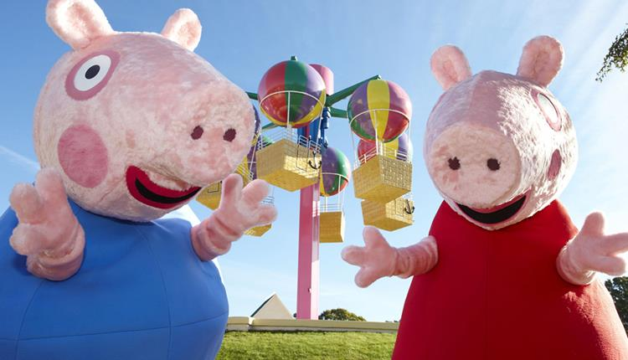
What makes a bad presentation?
Lack of preparation!
Incoherent structure.
Rambling / irrelevant / uninteresting content.
Poorly paced / pitched delivery.
Absent / unattractive / inaccessible visual aids.
Running over time.
Inability to answer questions.
Notes:
Talk through common presentation problems. The rest of the session will focus on ways to avoid them!

Slide 8
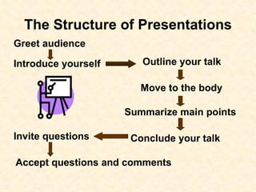
Presentation structure
Keep it logical – check the assignment requirements. Are there specific sections you need to include?
Clear beginning, middle, end.
Notes:
Talk through slide content.

Slide 9

Presentation timing
Consider …
Think carefully about more than one slide per minute.
Remember:
Certain slides can be delivered quickly (e.g., group introductions).
Others may longer to explain.
The time limit gives you an indication of the depth of detail expected.
Notes:
A general rule of thumb is one slide per minute (probably fewer!), so aim for 7-10 slides (including title / reference slide) for this presentation.
Remember:
Certain slides can be delivered quickly: ask students for an example. (e.g., team introductions).
Others may need several minutes to explain.
The time limit gives you an indication of the level of detail expected from you.
Activity next on slide design: what do you think of the next slide.

Slide 10
An Example of a Parituclarly Bad Slide Layout for a Presentation (Slide Layout – Bad)
Avoid backgrounds, animations and font colours that are distracting or difficult to read.
Always be consistent with the background that you use.
Avoid using complicated, CAPITALISED, or small fonts – they are difficult to read.
Use font size 18 or larger – use colours and change sizes to emphasise information, but don’t overuse or it will become confusing.
Notes:
Play animations and ask students to comment on some problems with this slide.
Spelling errors, repetitive title.
Weird and pointless animations and sound effects.
Background is too busy and hard to read text against.
Text is small and doesn’t make good use of the space available.
If students can manage to read the text, they will see it contains some further tips (summarised more clearly on the next slide).

Slide 11
Visual aids: top tips
1 main point / topic per slide.
Text formatting: font size 20 minimum, sans serif/calibri, avoid underlining.
Colour and contrast: avoid strongly patterned backgrounds.
Can be good to use bullet points (max. 6 per slide) and keywords.
Use images, graphs, diagrams and flowcharts where appropriate to illustrate your points.
Let these take centre-stage and talk around them – they are more than just add-ons!
Notes:
Run through the top tips on visual aids

Slide 12

Verbal communication
Clarity.
Volume.
Pace.
Intonation.
Accessibility.
Emphasis.
Notes:
Clarity – audience needs to hear what is being said as well as understand what is on the slide. This is key.
Volume – speak slightly louder than usual as may need to project in large room.
Pace – focus on speaking slightly slower than usual as nerves can often lead to speeding up.
Intonation – try not to speak in a monotone but move your voice up and down, add stress, etc.
Accessibility – ensure that jargon isn’t used, i.e. unnecessarily complicated words or phrases. It’s not about you, it’s about the subject matter.
Emphasis – tone but also tell the audience what’s important by pointing or saying so.

Slide 13

Non-verbal communication
‘Open’ posture.
Good eye contact with the audience.
Relevant gestures / linking to slides.
Avoid looking down / reading from notes if you can.
Some movement (but not constant pacing!).
Notes:
Talk through slide content.

Slide 14

Practise makes perfect
Presenter Coach: Office 365.
Study Skills 1-2-1 sessions.
Rehearse with an audience.
Record yourself.
Remember to consider key elements:
Clarity
Volume
Pace
Intonation
Accessibility
Gesture
Expression
Emphasis
Notes:
Ask students: a) do you rehearse at present? B) if so, how do you do this and how often? Click to bring in Presenter Coach bp. It helps you prepare in private to give more effective presentations. It evaluates your pacing, pitch, use of filler words, informal speech, euphemisms, and culturally sensitive terms, and it detects when you're being overly wordy or are simply reading the text on a slide. After each rehearsal, you get a report that includes statistics and suggestions for improvements. Play the video.
Click to bring in other bps.
Stress: for all strategies you need to take notes, reflect, experiment and improve!

Slide 15
Presenting as a group
What are some benefits? And some challenges?
Remember to consider:
How you want to introduce yourselves / your group.
Which group members are most confident at presenting? Does everyone need to present?
Do particular group members want to present specific sections? Can they be shared fairly?
How you will transition from one group member to the next.
Which group members might be best placed to answer certain questions.
Notes:
Pose opening question, wait for responses.
Benefits – division of labour, less focus on you individually. Help with answering questions.
Challenges – dividing tasks equally, making sure everyone contributes, time management, ensuring a coherent appearance and flow to the presentation.

Slide 16
Dealing with nerves
Common symptoms
Dry mouth.
Racing pulse.
Trembling.
Feeling short of breath.
Mind going blank.
Relaxation techniques
Take a drink with you.
Focus on breathing.
Draw attention away from yourself.
Make session more interactive.
Give yourself time.
Notes:
Nerves are normal; like stage fright. Once doing the presentation, likely will feel calmer. But, important it does not unduly effect your performance
All natural problems, what is important it thinking about strategies to help you relax,…
If you suffer from dry mouth, take a cup or bottle of water with you
Focus on breathing so not thinking about what doing.
Draw attention away from yourself: visual aids, dimmed lights etc
Ask your audience questions – make session more interactive
Give yourself time; pause at the start of each slide (this will also allow audience to reflect on past slide and read new one)
REMINDER: You can book 121s with the study skills team to practice presentations!!! Make use of this!!!! And with Counselling if anxiety is getting in the way of delivering effectively.

Slide 17

Dealing with questions (if applicable)
Think about what you might get asked.
Are certain team members best placed to tackle certain topics?
Ask for clarification if you don’t understand what’s being asked.
If you don’t have an immediate answer:
Take your time and don’t panic!
Explain you will look it up and get back to them.
Notes:
Check with lecturer now / at start of session – will students be asked questions? Here are some tips for dealing with them if so.

Slide 18
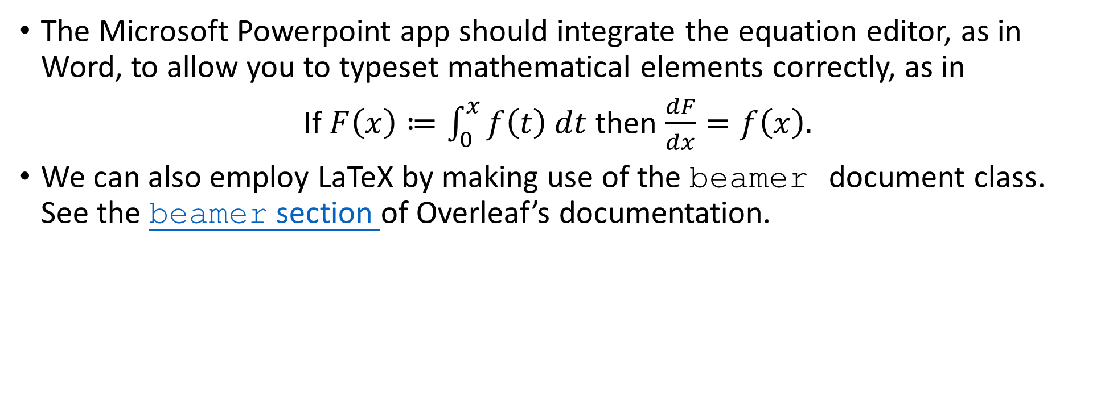
Typesetting maths in your presentations
The Microsoft Powerpoint app should integrate the equation editor, as in Word, to allow you to typeset mathematical elements correctly, as in
If $F\left(x\right)≔\int_{0}^{x}{f\left(t\right) dt}$ then $\frac{dF}{dx}=f\left(x\right).$
We can also employ LaTeX by making use of the beamer document class. See the beamer section of Overleaf’s documentation.

Slide 19
Summary
Take time to plan your presentation structure and prioritise your key points.
Less is sometimes more: how can you keep slide text to a minimum?
Embed effective visual aids throughout.
Know your topic and deliver it with confidence.
Check your timings.
Prepare for likely audience questions.
Notes:
Talk through slide content.

Slide 20

What questions do you have?

Slide 21
General writing and study skills support
For more general support on writing and study skills from the university, please visit the study skills webpages.
​
Notes:
21

